Slide 1
PLNT 4790/5790-01 Karibu Kenya
December 9 – 23, 2011
More Information available at:
http://www.uwyo.edu/KEEPS
Dr. Dave Wilson, Emeritus Faculty DPS
Dr. Emmanuel Omandi, Post Doc REWM
Photo: Dr. Wilson December 2010

Slide 2
Some basic Swahili for the beginner
English and Swahili are both taught to Kenyans, so they are fluent in both.
Karibu means “Welcome”
Twende means “Let’s go!”
Sasa means “Now”
Sawa means “Okay”
Asante means “Thank You”
So if I say “Twende kwa Kenya.”
You should say . . .
“Sawa. Twende, sasa!”

Slide 3
Flight to Kenya
London
Denver
Nairobi
Flight costs $1,100 to $1,800
prefer to book entire class on same flight
Early booking cheaper, Contact Instructor for Flights

Slide 4
28 passenger Bus
30 Passenger Plane
Three 9 passenger Vans

Slide 5
Major Points of Interest
Nairobi Open Markets
Many Small Local Growers (Nairobi & Kitale)
Nairobi Youth Prison
Great Rift Valley & Hell’s Gate National Park
Commercial Flower Production
Kericho Tea Plantations
Manor House BIA College in Kitale
Massai Mara Park

Slide 6
Killing time at the children’s zoo, waiting for students to arrive.
Yes, cheetahs purr!

Slide 7
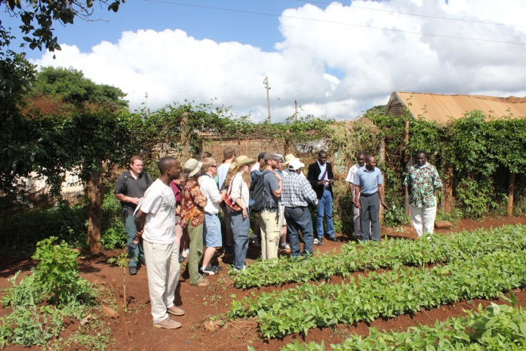
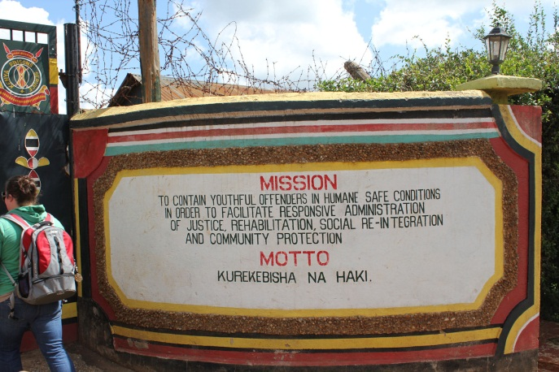
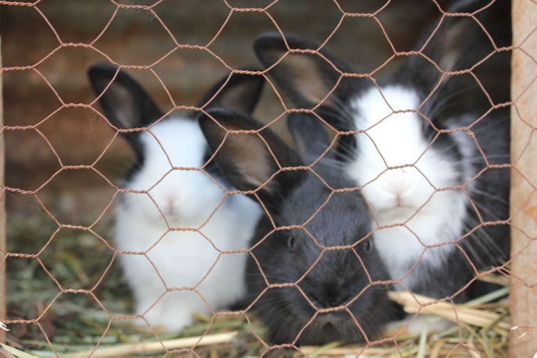
Group photo at Juvenile ( < 18 ) Prison Farm

Slide 8
G-BIACK Community Center

Slide 9
COSDEP

Slide 10
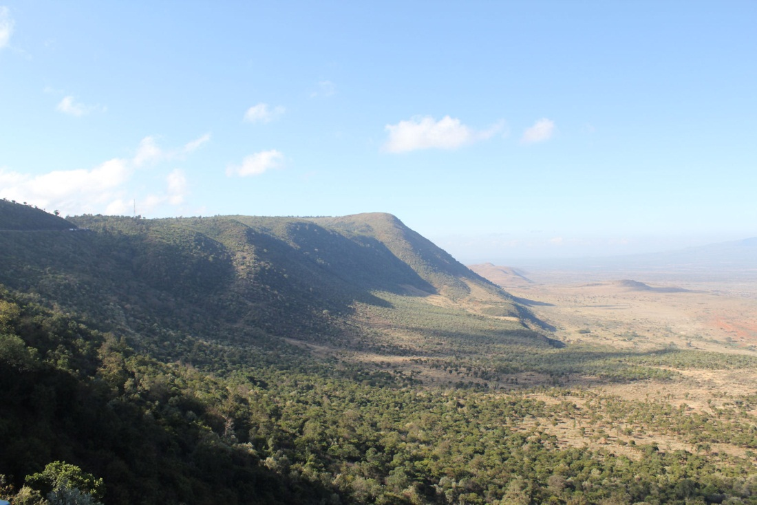
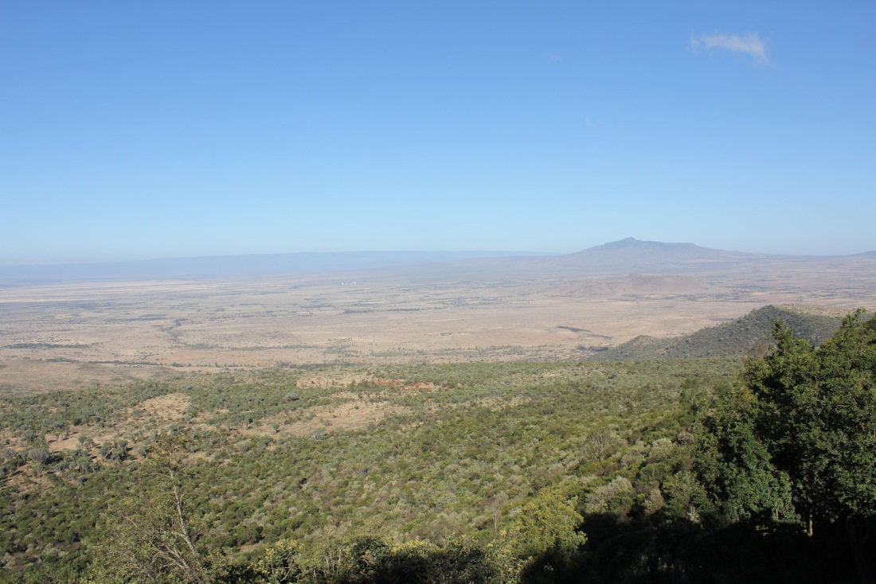
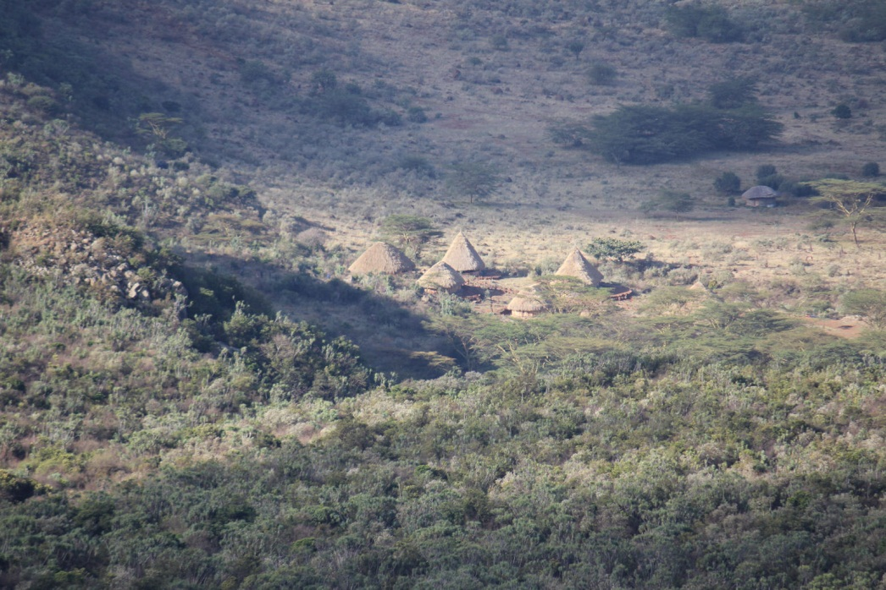
Great Rift Valley

Slide 11
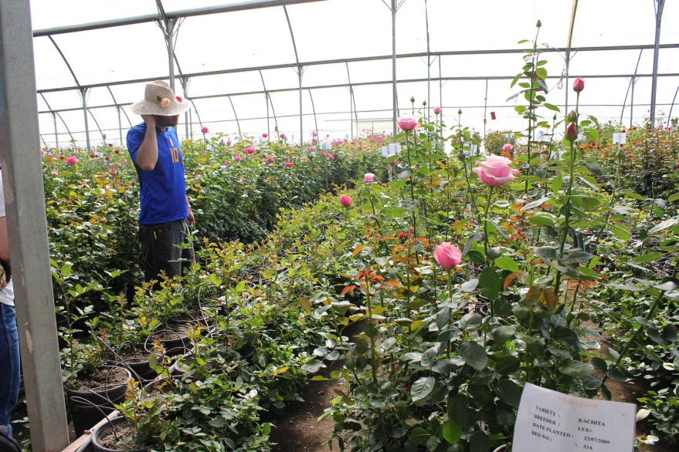
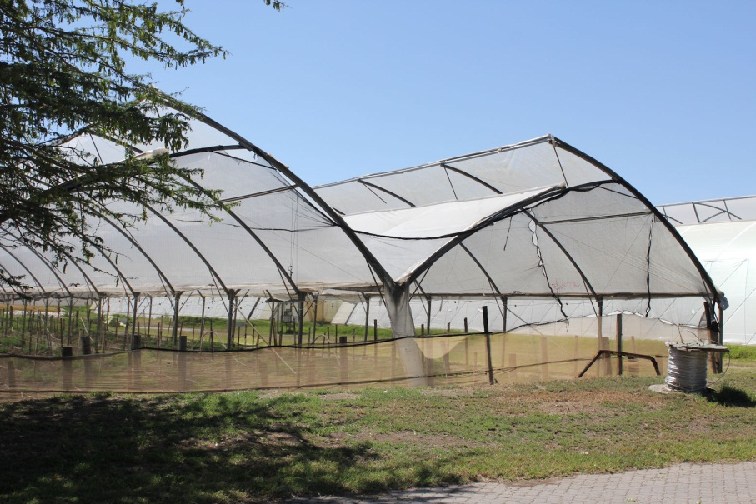
Commercial Cut Flower Production

Slide 12
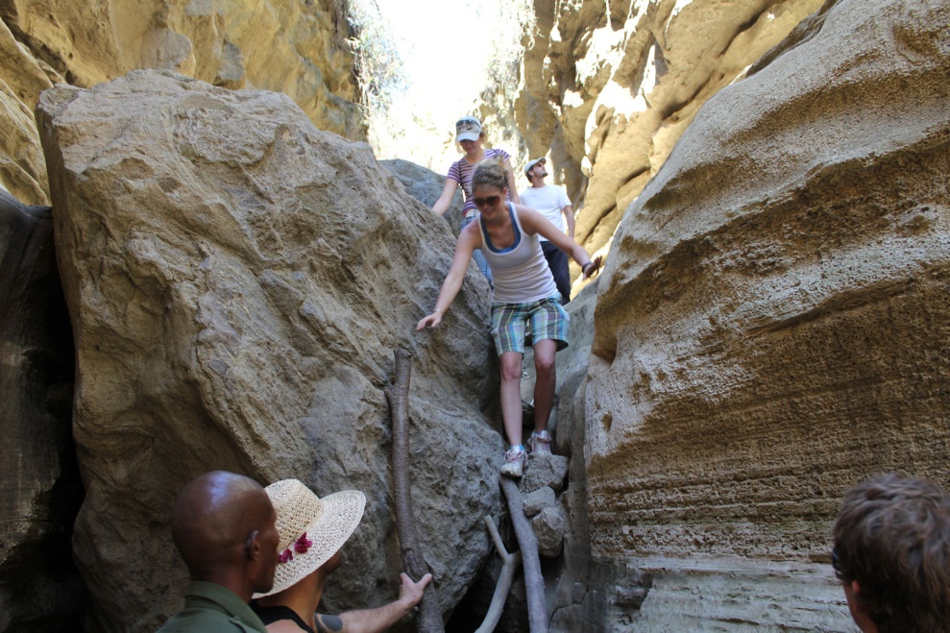
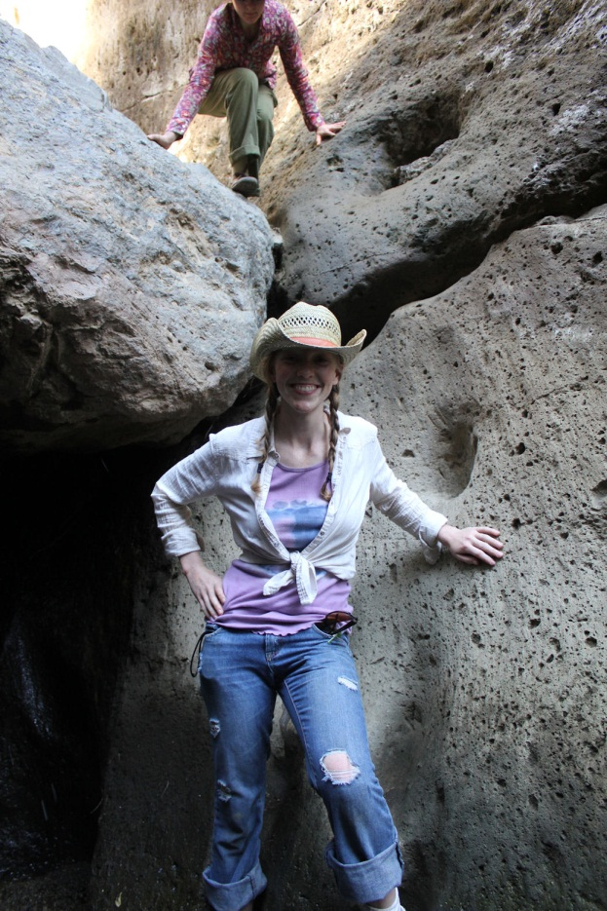
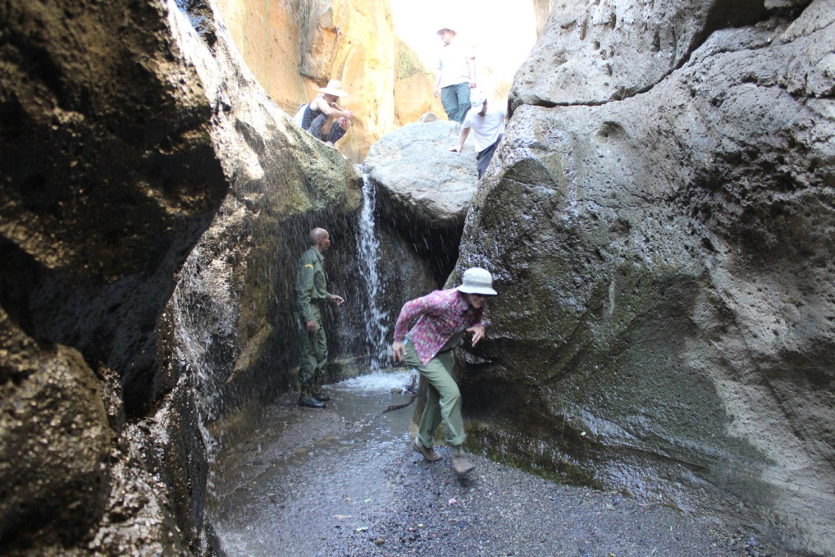
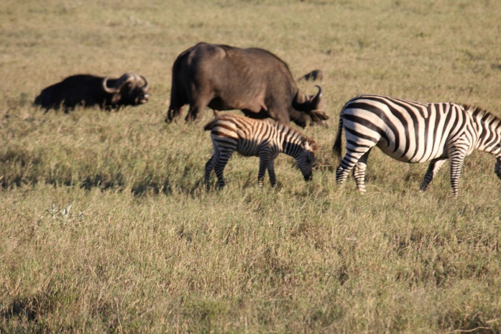
Hell’s Gate National Park

Slide 13
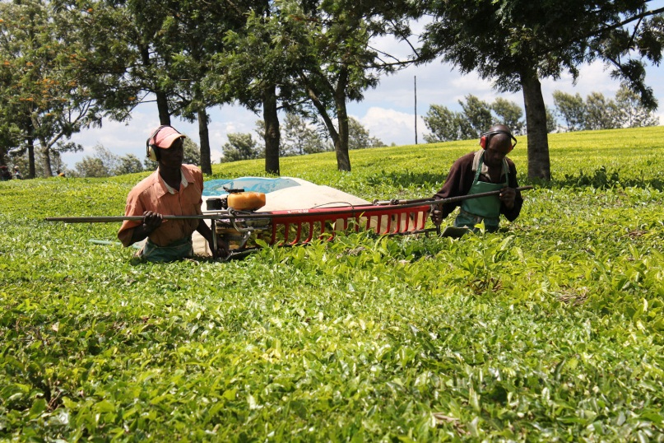
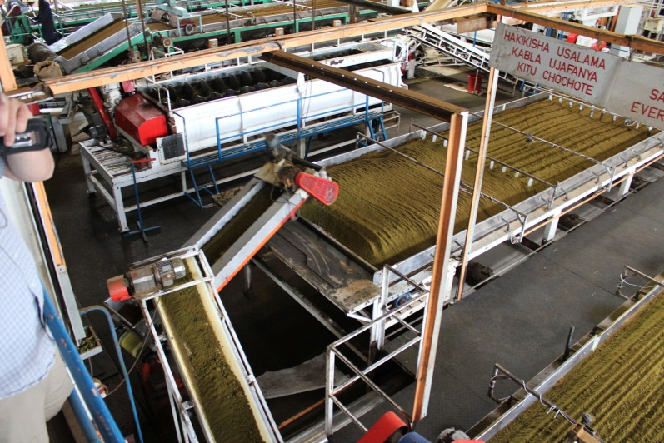
Kericho Tea Plantations

Slide 14
Manor House Donkey Power

Slide 15
Donkey Plow Training
(for the students, not the donkeys)

Slide 16
Students were encouraged to participate in hands-on BioIntensive Agriculture at Manor House

Slide 17
A borehole, the normal source of water in Kenya.

Slide 18
The local children were wonderful!

Slide 19
Agroforestry Project in Kitale

Slide 20
First picture taken on trip to Massai Mara Park

Slide 23
Great accommodations and food!

Slide 24
Solar Heated Hot Water!

Slide 25
Evening Programs by the Maasi Cattleman at the Mara Leisure Camp

Slide 26
Yep, even a pool!

Slide 27
Four ½ day game drives

Slide 32
Some even better wildlife photos yet to follow,
but for now . . . Back to the specifics.

Slide 33
Approximate Costs
Credit Fees ($188-$716 UG, $366-$1046 Grad)
Flight $1,100-2,000
Passport $0-$100 + $50 Kenya Entry Visa
Shots $100 - $500 dependent on health record
Room & Board $335 (first 9 and last day)
Flight Kitale to Nairobi $153
Van rental to Massai Mara Park $150
Tips $30 & Souvenirs $50
Park Entry Fees $20
MM Room/Board & Game Drives $350 (3 days)
Good Quality SLR Digital Camera $ ???
$2,500.00 to $4,000.00

Slide 34
Available Financial Support
IPO (3.0 gpa Required or Non-Trad or 1st Gen)
Cheney Study Abroad Grant $500-$1000 11/1/11
Ag “Beyond the Classroom” 2.7 gpa $200-$1000
Must be a College of Ag Student – late October
IPO Writing Competition (3.5 gpa, 2 awards) $2,500
Dick & Lynne Cheney Fellowship 10/1/11
(one award for undergrad and one grad)
IPO Course Support for Class Travel Costs $5,000
Covers van & bus travel in Kenya and to Massai Mara
IPO Faculty Travel Grant $2,000
Covers faculty expenses only

Slide 35
Concerning Immunization
Malaria Tablets: D-Oxycycline (cheap, no side effects)
Need prescription, take daily in Kenya, +3 months after
Required Shots include:
HEP A & B
Diphtheria/Pertussis/Tetanus (DPT)
Measles/Mumps/Rubella (MMR)
Typhoid/Polio/Rabies
Public Health may recommend others dependent on
current status in Kenya (i.e., meningitis, yellow fever)
Public Health on South 2nd Street, Cheaper than Student Health
Health Interview recommended $25 (single or group of 2-3)

Slide 36
Summer BIA Certificate Program
Three students from this year’s Karibu Kenya class will be selected for the program.
Students with greater than a 3.0 GPA qualify to receive $3,500 for the program.
Tuition/room/board is $1,000, flight $1,500
Minus miscellaneous costs, you would have ~$500 left over for spending cash.
You would receive a BIA Certificate upon graduation from the 3 month course.
Dates are mid-May to mid-August in Kitale.

Slide 37
All of the following photos of wildlife were taken by the instructor on the
2010 Karibu Kenya Trip
to Massai Mara and Hell’s Gate National Parks with a
Canon T2 SLR Digital Camera.

Slide 38
Photo: Dr. Wilson December 2010 – African Elephant (3 generations)

Slide 39
Photo: Dr. Wilson December 2010 - Giraffe

Slide 40
Photo: Dr. Wilson December 2010 - Hippo

Slide 41
Photo: Dr. Wilson December 2010 – Cape Buffalo

Slide 42
Photo: Dr. Wilson December 2010 – African lioness on fresh kill

Slide 43
Photo: Dr. Wilson December 2010 – Zebra & colt

Slide 44
Photo: Dr. Wilson December 2010 – Wildebeast herd

Slide 45
Photo: Dr. Wilson December 2010 – Topi and calf

Slide 46
Photo: Dr. Wilson December 2010 –
Grant’s Gazelle

Slide 47
Photo: Dr. Wilson December 2010 – Thompson’s Gazelle

Slide 48
Photo: Dr. Wilson December 2010 - Impala

Slide 49
Photo: Dr. Wilson December 2010 - Hartebeast

Slide 50
Photo: Dr. Wilson December 2010 - Eland
Photo: Dr. Wilson December 2010 – Black Rhino

Slide 51
Photo: Dr. Wilson December 2010 - Warthog

Slide 52
Photo: Dr. Wilson December 2010 - Ostrich

Slide 53
Photo: Dr. Wilson December 2010 – Secretary Bird

Slide 54
Photo: Dr. Wilson December 2010 – Emperor Cranes

Slide 55
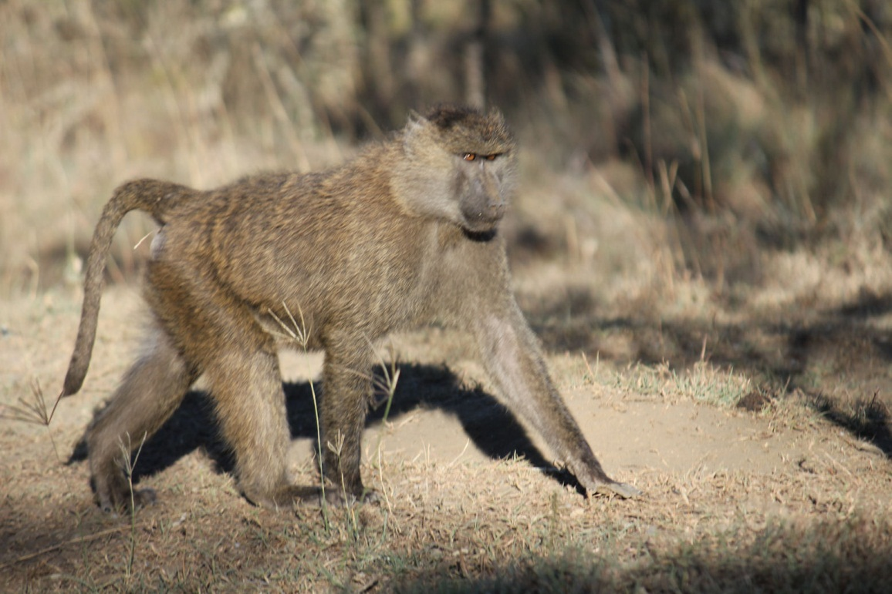
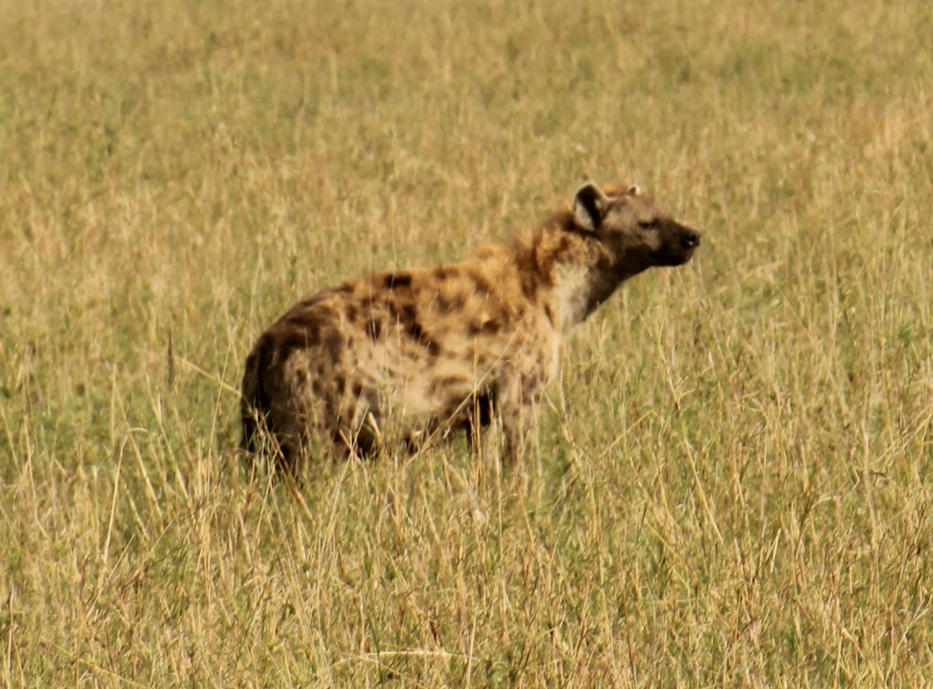
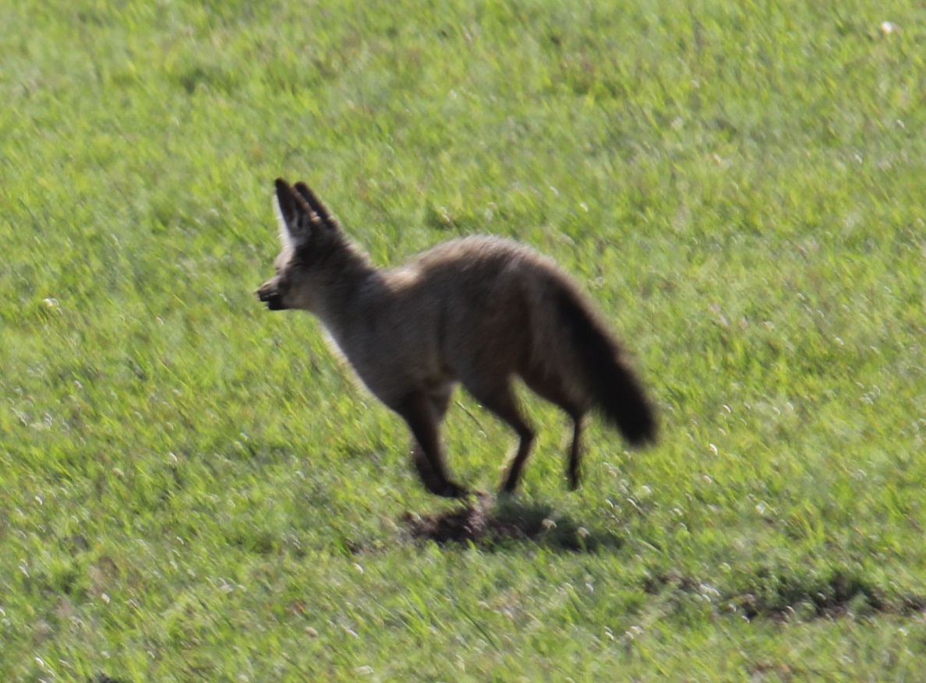
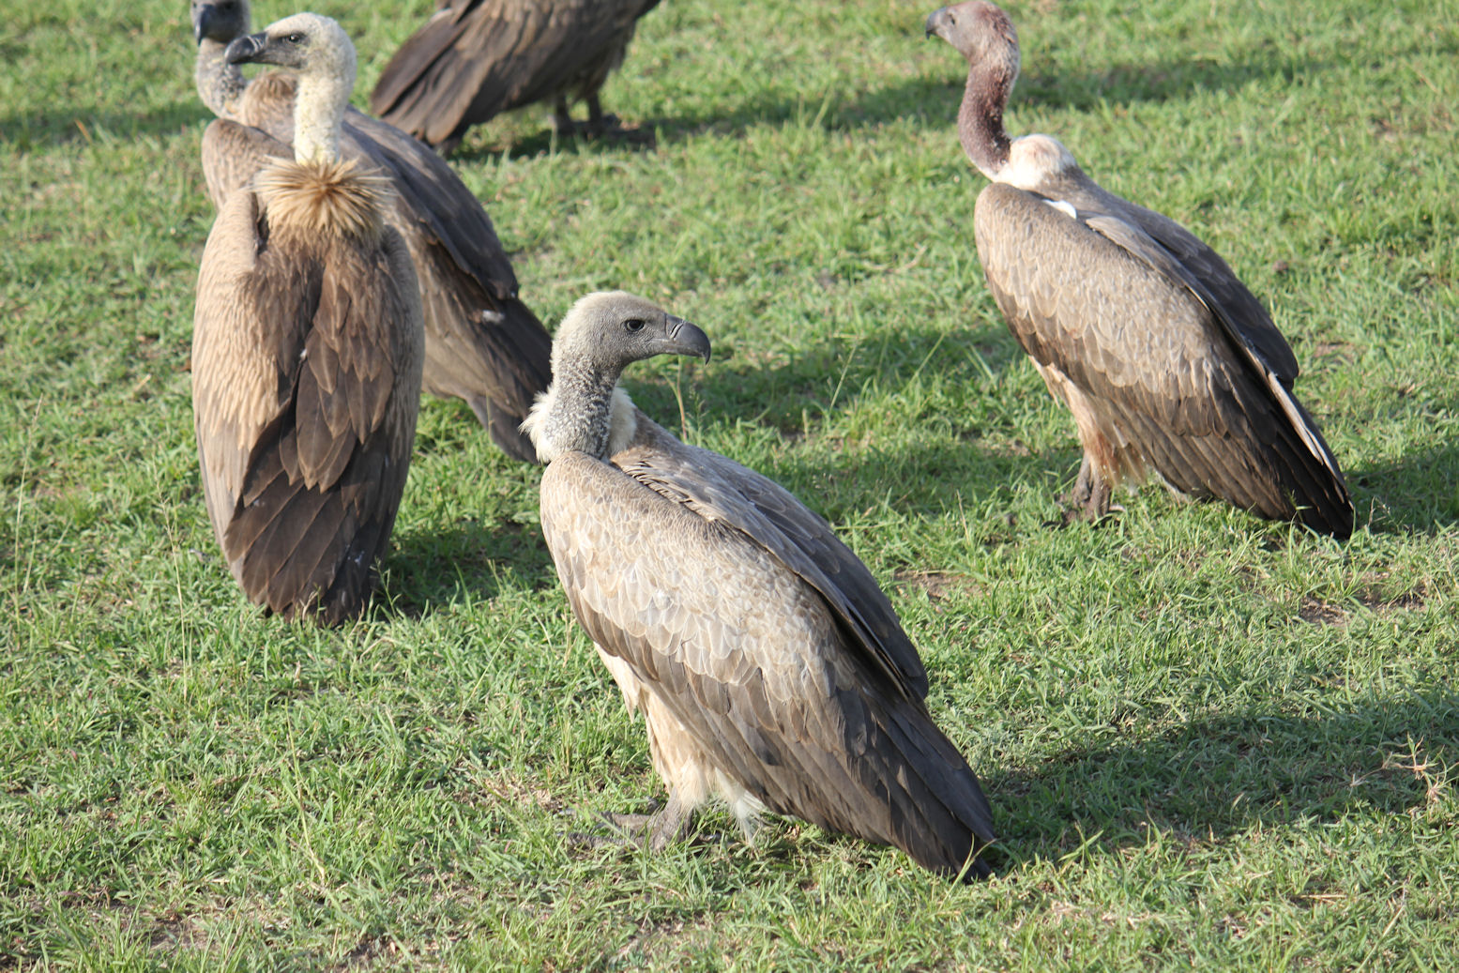
Hyena
Baboon
Bat Eared Fox
Vultures

Slide 56
Photo: Dr. Wilson December 2010 - Jackal

Slide 57
Photo: Dr. Wilson December 2010 – Serval Cat

Slide 58
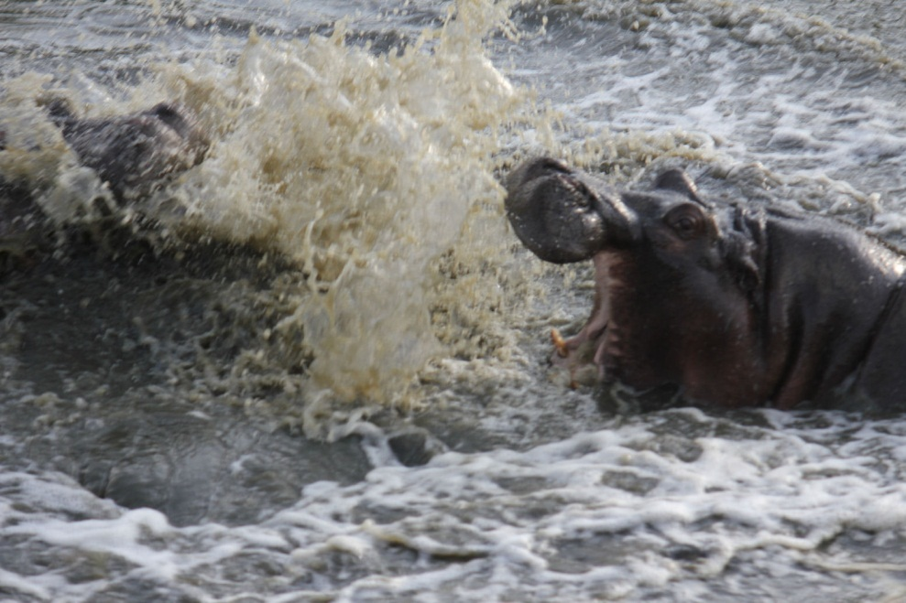
Karibu Kenya Registration
Undergraduates: PLNT 4790-01 CRN 15297
Graduate Students: PLNT 5790-03 CRN 15298
This Class is “Controlled Enrollment” – closes 10/21
Online Controlled Enrollment Authorization Form
http://www.uwyo.edu/registrar/Students/Forms_and_Petitions.html Complete form and submit electronically OR pickup signed form (today) from Dr. Wilson & take to Registrar – then register
Maximum of 18 students (combined enrollment), first come first serve, regardless of degree or major. Last year course filled by October 1st (2010)
Next Meeting for registered students is on October 20th (R), 5:15 pm AgC 4040

Slide 59
Questions!
Karibu Kenya is unlikely to be offered in 2012,
but will probably be available again in 2013.
For those of you ready to commit tonight, stick around – there are two more slides.

Slide 60
If you are planning on going, you will need to do the following, soon!
Pickup an Enrollment Authorization Form
Give me your Passport status
I have Student Financial Support info. You will need to apply before October 1st
I have Flight information
Download the Syllabus after you leave at http://www.uwyo.edu/KEEPS
Get passport, schedule shots, apply for scholarships & book flight before October 20th meeting.

Slide 61
Agenda for October 20th Meeting
Solidifying flights (bring flight info)
Immunization & Passport Progress
Filing Student Financial Support requests
What to Pack
3rd World Cultural Issues Awareness
Course Grading & Expectations
Schedule November IPO Meeting
Schedule December Pre-departure Meeting
ALL registered students are required to attend ALL meetings.

